Slide 1
Lecture
Microsoft Access and
Relational Database Basics

Slide 2
What’s a Relational Database?
“A collection of records stored in a computer in a systematic way.”
“A database consisting of separate tables, having explicitly defined relationships, and whose elements may be selectively combined as the results of queries”

Slide 3
SQL
SQL - Structured Query Language is the programming language that underlies Access queries
A database computer language designed for managing data in relational database management systems (RDBMS), and originally based upon Relational Algebra
Like HTML underlies web pages, SQL underlies databases

Slide 4
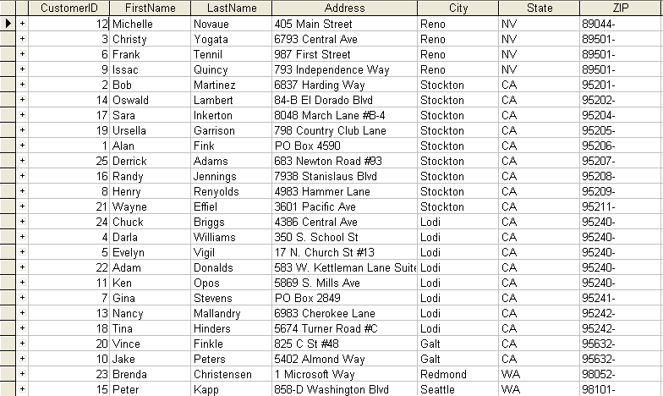
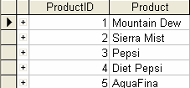
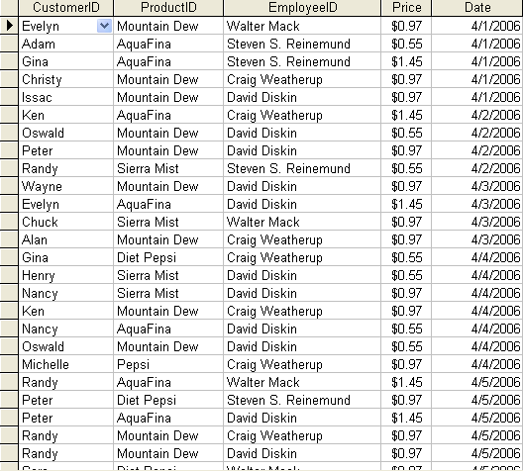
What’s a Database? (cont.)
Customers
Products
Orders

Slide 5
Benefits to a Database
Collaboration among multiple users
Web integration
Improved security
Easer for end-users
Data integrity

Slide 6
Database Software
Oracle
FoxPro
dBASE
Access
Firebird
MySQL
Sybase

Slide 7


Access vs Excel
Handles Lots of Data
Quick and Easy Calculations
Customizing Charts
Security and Data Protection
Complex Reports
Easy to Learn
vs
vs
vs
vs
vs
vs

Slide 8
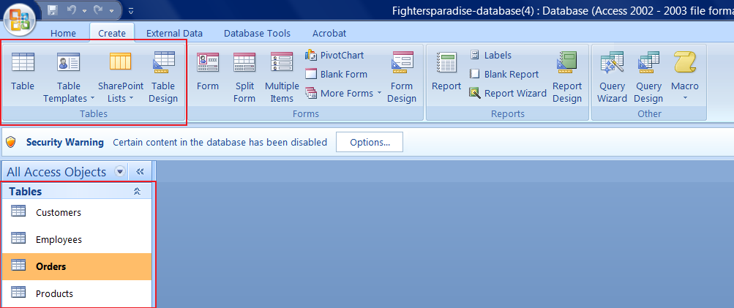
Tables
Tables: The “spreadsheets” of your database. Each table contains rows of related data called records, and columns of information called fields.

Slide 9
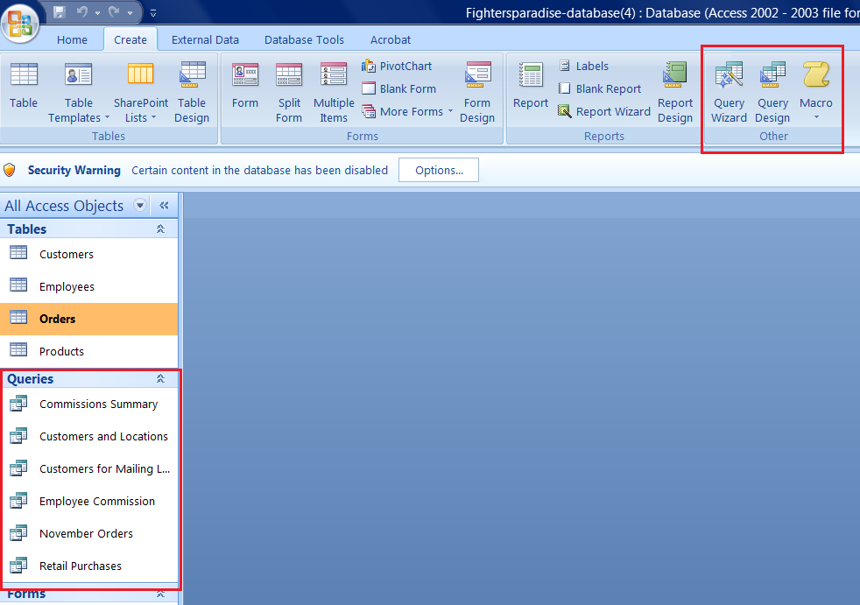
Queries
Queries: The “questions” you have stored into the database, such as a list of all customers who have purchased over $500.

Slide 10
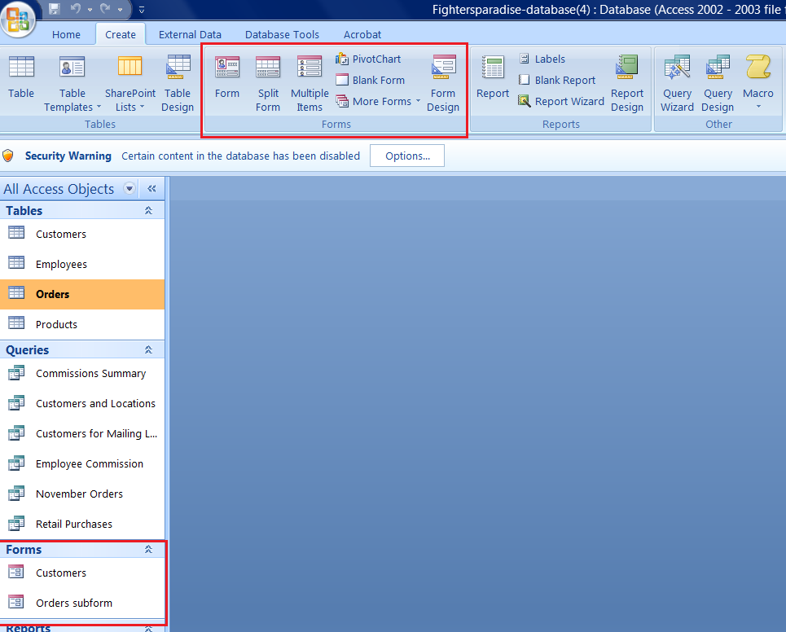
Forms
Forms: A graphical interface for users to view and edit the data in a table. Forms can be customized with logos, color, fonts, and even buttons that automate tasks like a macro.

Slide 11
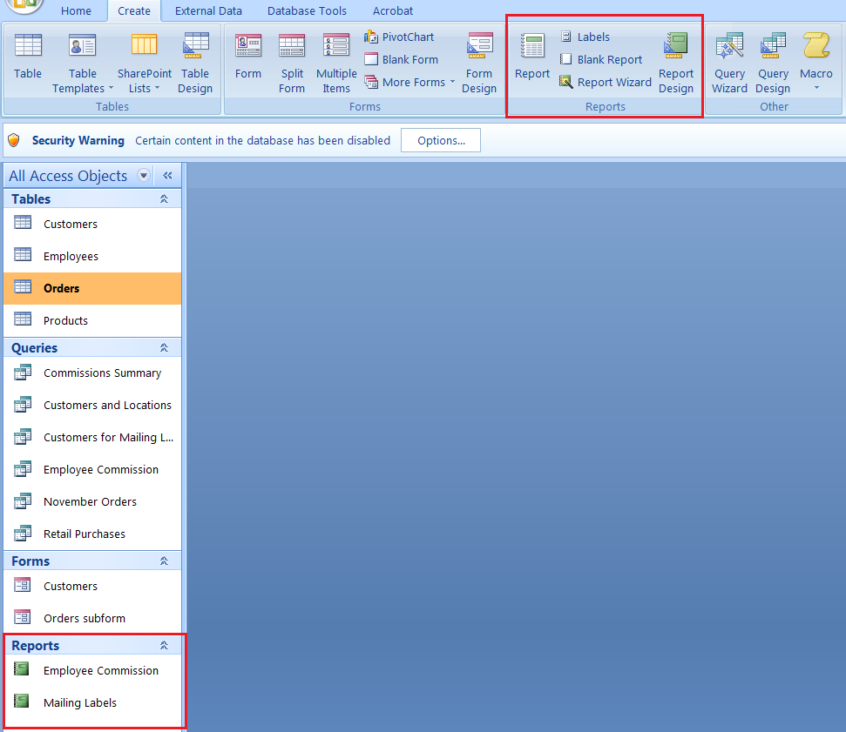
Reports
Reports: Results from a table or query that is to be printed (on paper) in a specific format. Reports, like forms, can have logos and fonts.

Slide 12
Table Relationships
Payments
Invoices
Employees
Databases almost always have multiple tables that are all related.
Line Items
Customers

Slide 13
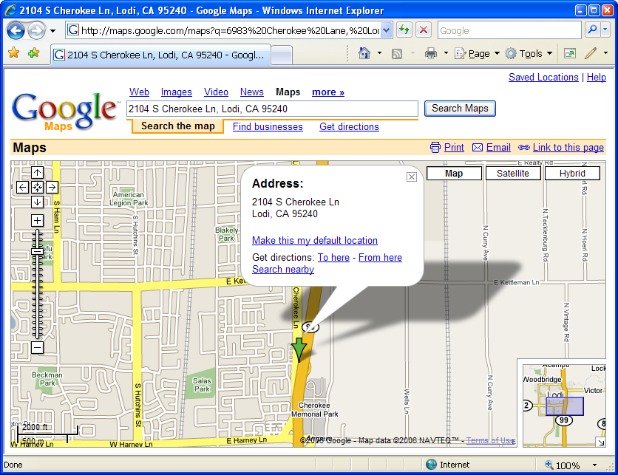
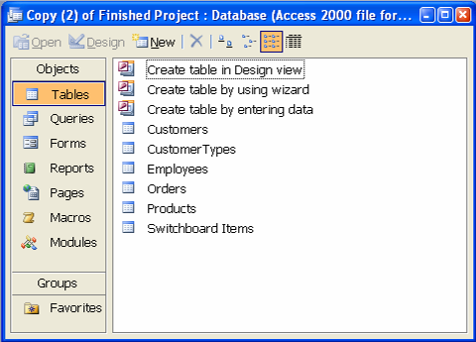
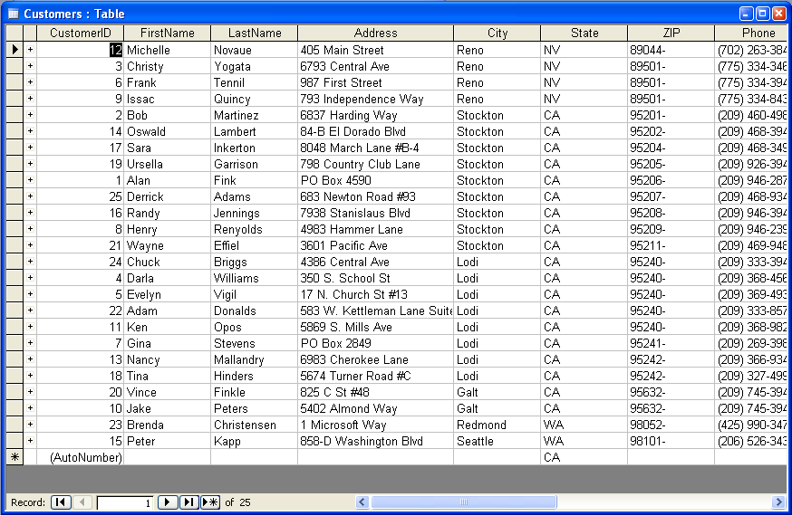
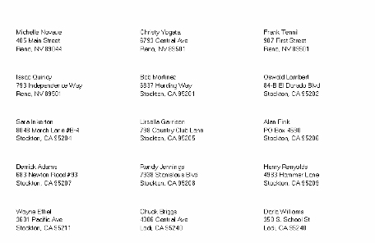
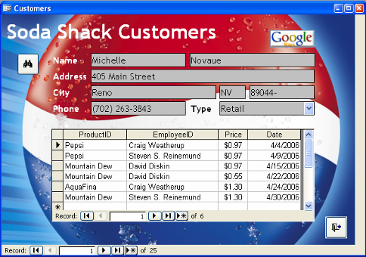
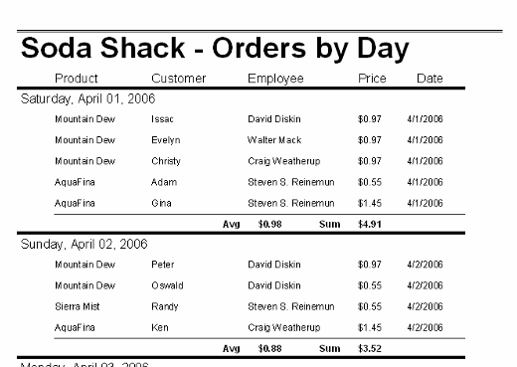
Your Project

